Slide 1
Lecture – 09

Slide 2
System Design
A system is defined as a collection of components, that are connected to form a coherent entity with a specific function or purpose. Example: Computer.
The function of a system is defined by the functions of its components and how the components are connected.

Slide 3
System Representation
A directed graph is used to represent a system. It consists of a set of objects V = {v₁, v₂,….,v_{n}} called nodes or vertices and a set of edges E whose members are ordered pairs of nodes. The edge E = (v_{i}, v_{j}) joins node v_{i} to node v_{j}.
Our system of interest consists of two classes of components: a set of information processing components (C) and a set of lines that carry information signals between components.

Slide 4
Block Diagram
In modeling the system by a graph, we associate C with the nodes of G and S with the edges. The resulting graph is known as block diagram.
Each component is represented by a block or box in which it’s name or function can be written.
Example: Block diagram of EX-OR logic circuit.
X₁
AND
NOT
OR
X₁⊕ X₂
NOT
AND
X₂

Slide 5
Structure
The structure of a system is an abstract graph consisting of its block diagram with no functional information.
A structural description names components and defines their interconnection.

Slide 6
Behavior
The behavioral description determines for any given input signal a to the system, the corresponding output f(a). Function f is the behavior of the system.
The behavior f may be represented in many different ways:
Truth table.
Mathematical equation of form f(a) = f(x₁, x₂)
HDL (Hardware Description Language).
Input a x₁ x₂ | Output f(a)
0 0 | 0
0 1 | 1
1 0 | 1
1 1 | 0
f(0,0) = 0
f(0,1) = 1
f(1,0) = 1
f(1,1) = 0
A block diagram conveys structure rather than behavior.

Slide 7
Hardware Description Language (HDL)
HDL resembles a high-level programming language such as ADA and C.
Advantages:
It provides precise, technology-independent descriptions of digital circuits at various levels of abstraction, primarily the gate and the register levels.
It is used for documentation.
It can be processed by computers and is suitable for CAD.

Slide 8
Hardware Description Language (HDL)
x
Half Adder
x y | sum carry
0 0 0 1 1 0 1 1 | 0 0 1 0 1 0 0 1
sum
y
carry
entity half_adder is
port (x, y: in bit; sum, carry: out bit); end half_adder ;
architecture behavior of half_adder is begin
sum <= x xor y; carry <= x and y; end behavior ;

Slide 9
Design Process
Design Problem:
Given a desired range of behaviors and a set of available components, a structure formed these components that achieves the desired behavior with acceptable cost and performance.
Beside assuring the correct behavior of the new design, it is required to minimize the cost measured by the cost of manufacture and to maximize the performance as measured by the speed of operation.
Other performance and cost related constraints are high reliability, low power consumption and compatibility with existing system.
Generally the design problem is broken into smaller, easier tasks. These smaller problems can be solved independently by different designers. Each major steps is implemented by an iterative design process.

Slide 10
Flow chart of an Iterative Design Process
Begin
Construct an initial design
Evaluate its cost and performance
Modify the design to meet the goals
Are the design goals met?
No
End

Slide 11
Computer-aided Design
CAD tools are used to automate, at least in part, the more tedious design and evaluation steps and contribute in three important ways to the overall design process:
CAD editors or translators convert design data into forms such as HDL descriptions or schematic diagrams, which humans, computers, or both can efficiently process.
Simulators create computer models of a new design, which can mimic the design’s behavior and help designers determine how well the design meets various performance and cost goals.
Synthesizers automate the design process itself by deriving structures that implement all or part of some design step.

Slide 12
Design Levels
Processor level, also known as architecture, behavior
or system level.
Register level, also called the register-transfer level.
Gate level, also called the logic level.
Level | Components | IC Density | Information unit | Time units
Gate | Logic gates, filp- flops | SSI | Bits | 10⁻¹² to 10⁻⁹s
Register | Registers, counters, combinational circuits, small sequential circuits | MSI | Words | 10⁻⁹ to 10⁻⁶ s
Processor | CPUs, memories, IO devices | VLSI | Blocks of Words | 10⁻³ to 10³ s

Slide 13
System Hierarchy
Design levels are treated as high or low, depending on the complexity.
A component in any level L_{i} is equivalent to a (sub) system of components taken from the level L_{i-1} beneath it.
x₁ z₁
1
2
x₂
X
Z
A
B
A
B
z₂
x₃
3
4
5
Low level
High level

Slide 14
Example of Hierarchical System
XOR
sum
x
Half adder (Low level)
NAND1
NAND2
carry
y
x
 | Half Adder | s
um
Half adder ( High level)
y
carry

Slide 15
System Hierarchy
The components of each level of a hierarchical system is self-contained and stable entities. The evolution of a system from simple to complex organization is possible for the existence of stable intermediate structures.
The design of a complex system is composed of 3 steps:
Specify the processor level structure
Specify the register level structure of each components identified in step 1
Specify the gate level structure of each components identified in step 2
This design approach is known as top-down.

Slide 16
The Gate Level
Combinational Logic: Read Yourself
Flip-flops: Read Yourself

Slide 17
Sequential Circuits
A sequential circuit consists of a combinational circuit and a set of flip-flops.
The combinational logic forms the computational or data- processing part of the circuit.
The flip-flops store information on the circuit’s past behavior. This stored information defines the circuit’s internal state Y.
If the primary inputs are X and the primary outputs are Z, then Z is a function of both X and Y, denoted by Z(X,Y).
It is usual to supply a sequential circuit with a precisely controlled clock signal that determines the times at which the flip-flops change state; the resulting circuit is said to be clocked or synchronous.

Slide 18
Sequential Circuits
It is usual to supply a sequential circuit with a precisely controlled clock signal that determines the times at which the flip-flops change state; the resulting circuit is said to be clocked or synchronous.

Slide 19
Serial Adder
It computes two unsigned binary numbers X₁ and X₂ of arbitrary length Z = X₁ plus X₂.
The numbers are supplied serially and the result is also produced serially.
The output computed in clock cycle i is c(i)z(i) = x₁(i) plus x₂(i) plus c(i-1)
where c(i-1) is determined from the adder’s present state S(i).
S₀ means that c(i-1) = 0 and S₁ means that c(i-1) = 1

Slide 20
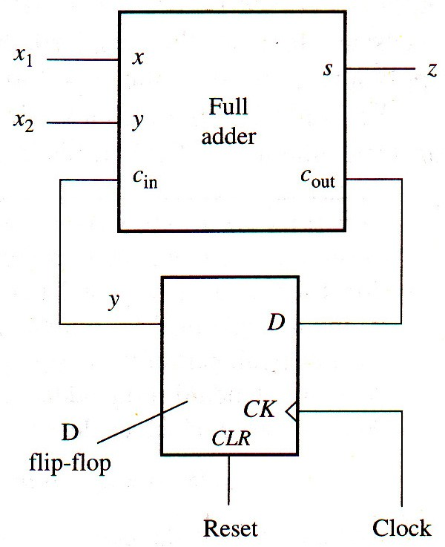
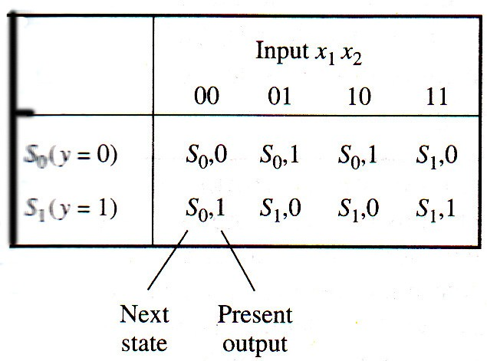
Serial Adder
State Table
Logic Circuit

Slide 21
4-bit Stream Serial Adder
It adds 4 number streams.
The output computed in clock cycle i is
sum(i) = c(i)z(i) = x₁(i) plus x₂(i) plus x₃(i) plus x₄(i) plus c(i-1)
If c(i-1)=0 and each x_{j}(i)=1, then
sum(i) = 1 plus 1 plus 1 plus 1 plus 0 = 4 = 100₂, so
c(i) = 10₂, sum(i) becomes 6 = 110₂, making c(i) = 11₂. Finally, c(i-1) = 11₂ makes sum(i) = 111₂, and c(i)= 11₂. So, the carry data ranges from 00₂ to 11₂.

Slide 22
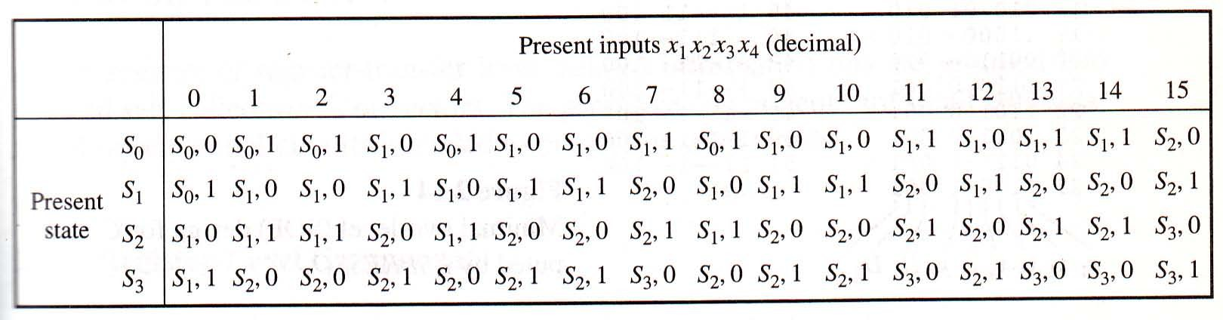
4-bit Stream Serial Adder
State Table

Slide 23
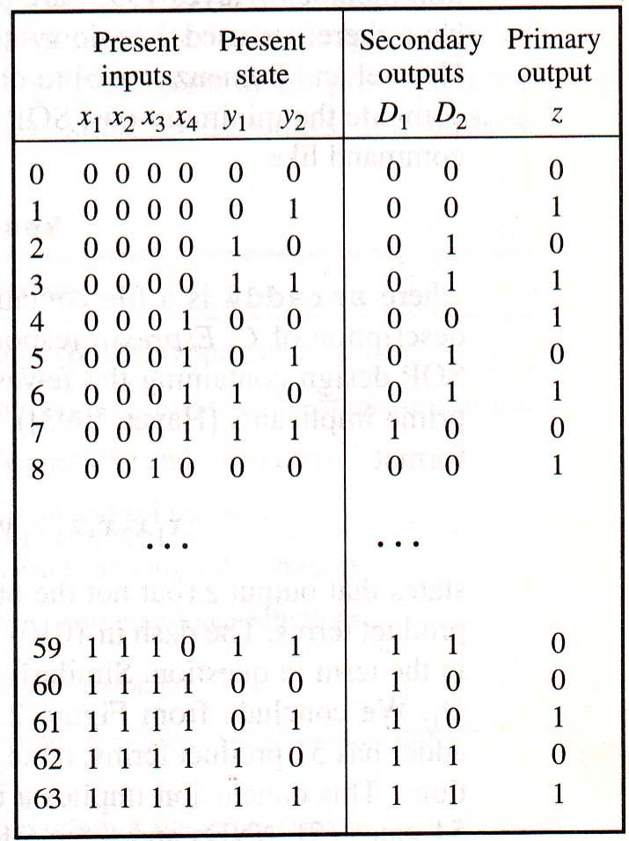
4-bit Stream Serial Adder
Truth Table

Slide 24
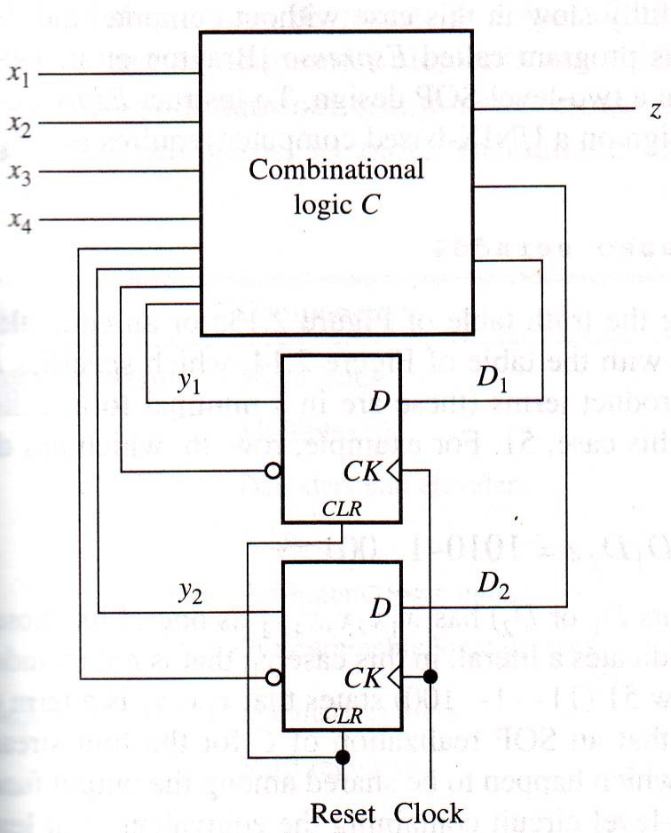
4-bit Stream Serial Adder
Overall Structure

Slide 25
The Register Level
Word Gates: Read Yourself
Multiplexers: Read Yourself
Decoders: Read Yourself
Encoders: Read Yourself

Slide 26
4-bit Magnitude Comparator
It has eight input lines, so the truth
table has 2⁸ = 256 rows. So a SOP or POS realization is impractical because of the many gates involved.
X>Y is equivalent to X-Y>0. Y=2^{n}-1-Y.
So, X-(2^{n}-1-Y)>0 implies X+Y>2^{n}-1=11…1
If the above inequality is satisfied, the C_{out} will be 1.
X
Y
4
4
4-bit magnitude comparator
X<Y X=Y X>Y

Slide 27
4-bit Magnitude Comparator
The original magnitude test X-Y can be performed as follows:
Compute Y from Y using an n-bit word inverter.
Add X and Y via an n-bit adder and use C_{out} as the primary output. If C_{out} = 1, then X>Y; if c_{out} = 0, then X≤Y
By switching X and Y, X<Y can be generated in exactly the same manner.

Slide 28
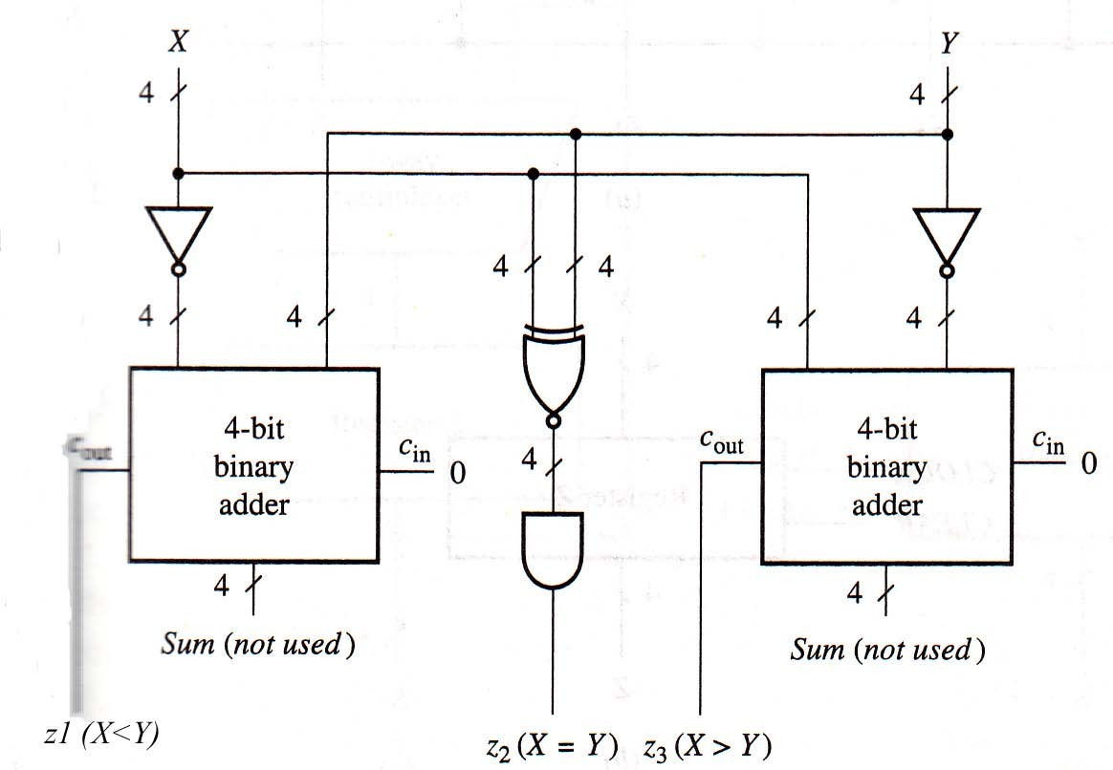
4-bit Magnitude Comparator

